Slide 1
East Coast Legal Research
November 13 – 15, 2017
Julie Roberts-Elliott
UX Design Researcher

Slide 2
Research Highlights
IT Discussion:
MPS and the company have a quarterly discussion – the Legal Firm may bring up challenges or the MPS provider will offer suggestions of software solutions.
  The IT personnel will kick off a pilot program to test new software for the Firm not the Solutions provider (internal has the knowledge of security and environment)
  Software integrators work in the IT department and want shrink wrapped programs that allow them to configure applications – the MPS or Solution provider needs to be prepared with a workflow that works in their environment.
Security is a big deal in the legal department – the number 1 focus.
  No developments from the print industry for security, IT does not know of any security solutions
  No secure solution for printing from mobile devices
  Solutions that we use need to be integrated with Active Directory
Second focus is the multi generational workforce – help with their needs across all of it
Device/PC Log in:
All users log into their PC and are able to access most of their applications.
All users have separate user names and passwords for certain applications like Relativity and client server access – have separate accounts (cloud hosting on the relativity site).
Users used a pin to send a print job as well as a matter number to track billing.
Pin was also used to scan a document in some offices.
Users were mixed about badging/mobile device to get access to document management software. They felt that an alternative method should be added like a pin in case they forgot their badge or mobile device.

Slide 3
Research Highlights Continued
Document Management:
Users do not use the document management as a main storage for matters/cases, they use their internal server to store matters/cases.
Users will scan to email so that they can manipulate the document before saving it to the server or the document management.
  Users did not like the touch screen keypad to type on so they just title the document with the number 1
  Users felt that they needed to look over the document to make sure everything was scanned in correctly.
Prototype:
All users liked being able to access their matters from the control panel
Users felt that a “real” keyboard at the MFP would be needed in order for this solution to be efficient.
The capability of being able to send scans to multiple destinations was of great interest and all users would appreciate having that capability.
The preview screen was something that they liked to quickly glance at for large documents to see if they are formatted correctly but would not hold up the printer to inspect a large scan job.
  For scan jobs that have only 2 or 3 pages they would use the preview screen to review the documents.

Slide 4
Legal Research – 2 offices/7 paralegals/ 2 IT Professionals
Legal professionals spend majority of their time at their workstation
  Paralegals (target research customer) spend 8+ hours a day on their desktops performing,
  Case/client management
  Document editing and review (bate stamping, labelling, redacting)
  Document Assembly for trial
  Initiating print/scan processes
Print/Scan processes are critical to a paralegals workflow and will continue to be
  A paralegal’s daily workflow in a legal office entails printing and scanning processes that are critical to their trial preparations as well as document management.
The MFP’s location, proximity and ease of use matters to paralegals
  Paralegals had A4 MFP’s that were used all the time and about 6 paralegals used those.
  Larger A3 devices were placed one or two to a floor for all paralegals to use. These are used for bigger jobs as well as functions such as hole punch and space pages.
  Paralegals have figured out how to take the redundancy out of tabbing and renaming pages by using excel formulas.
  Paralegals want to access or send their documents to the server. These users did not use Document Management Software (iManage) except to hold briefs and current versions. The full matter is held on an internal server.

Slide 5
Common Trends and Pain Points – Legal Customer Interviews
TRENDS | PAIN POINTS
Printing login for billing the customer – 5 digit employee code and then matter number | Constantly running to your desk because that is where you have to go to print, no where else can you print from.
One big A3 device for the floor, with multiple A4 devices that serve 6 to 9 people | Tying up the devices with large print jobs so others are unable to use them.
In house group that does the large printing | Page maximum on the copier and then redirected to in house department if over the page limit file size limit –sent somewhere else if too big to go to inbox
All electronic documents are emailed and re-saved. -*Servers are the most commonly used main repository. | Scanned documents at the MFP are only able to send by scan to email. *No function at MFP to allow scan to server or scan to document mangement
PDF / Adobe Workflow- key solution used. Used for document editing, creation, review and assembly. Excel is used very commonly for formulas to reduce human err | Inconsistent discovery document formats and embedded attachments. Labeling and numbering trial folders is very time consuming
Do not work outside of the office firewall unless issued a secure laptop by IT
Bulk printing/scanning is done on Konica – Minolta Copy devices (often situated in common area in the back office). *Personal printers are not commonly used. | Electronic vs. paper file are dynamic among attorneys. Some are all paper as others are all digital, while some need both.
Imanage is used but not so much for Document storage, the server is where the main copy is stored | iManage is used for version control but feedback is that other users can version up while the user is making edits
Cloud computing/migration is prevalent, but not as frequently used due to security and confidentiality risks/concerns. | Travel back and forth to desktop PC and MFP for print/scan needs and document retrieval from different apps/systems.

Slide 6
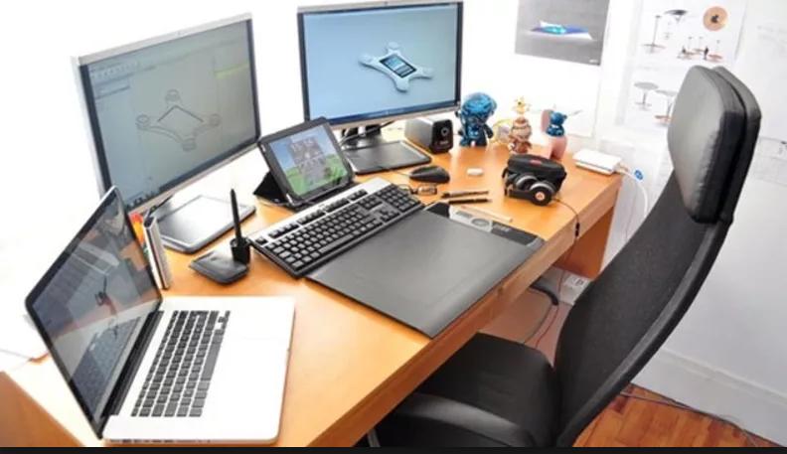
Sylvia, Paralegal
Sylvia is the paralegal at a large legal firm comprising of 40+ employees. She’s a multi-tasker and is proficient in the work she does. She communicates with multiple parties and prepare all documentation needed for trial. She is the pillar of the legal firm. Her clients and attorney/(s) would be lost without her help on all the complex legal processes. She would love to have her daily workflow and tasks streamlined to save herself time and clients money.
Legal Guru
Efficiency
Accuracy
Client Facing
Result Oriented
Work Environment
Technology
Print and Scan
Distributed partners
Client visits, Records, legal
Documents, storage
3rd party MPS
Tailored yet common technology
Workflow focused
Open to new technology
Inter-connected
Print and scan is essential
Shared MFP’s in convenient location
Medium Volume
Bulk outsourced to LPO
Motivations
Improve work efficiency
Building and nurturing client and attorney relationships
Accountability
Attitude
Uses best solutions for most efficient workflow
Likes to be in control, uses workarounds for solving problems
Detail oriented, organized, confident
Key Attractors
Fast/accurate solutions
Tools to increase efficiency
Routing solutions
I wish there was a way to make my regular workflow more efficient so I can get it done more efficiently and also save my clients some money.
Notes:
Value feature benefits reflects in DT

Slide 7
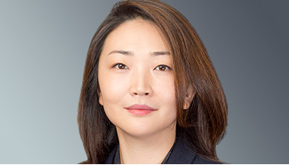
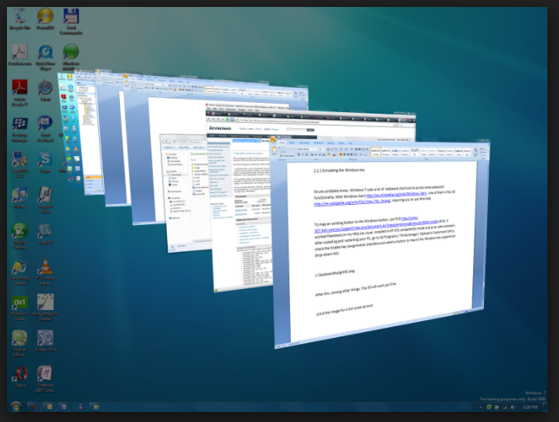
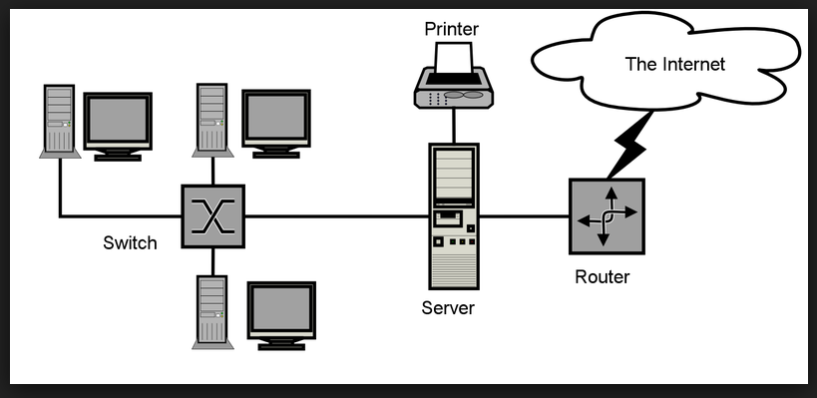
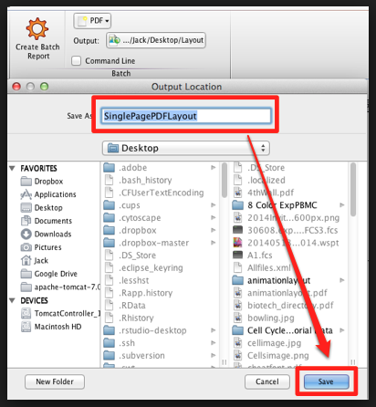
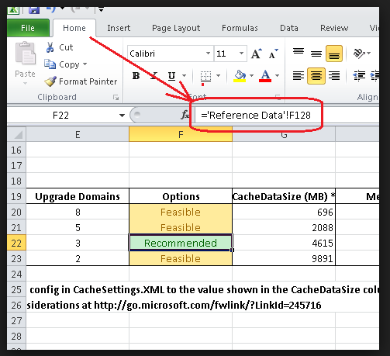
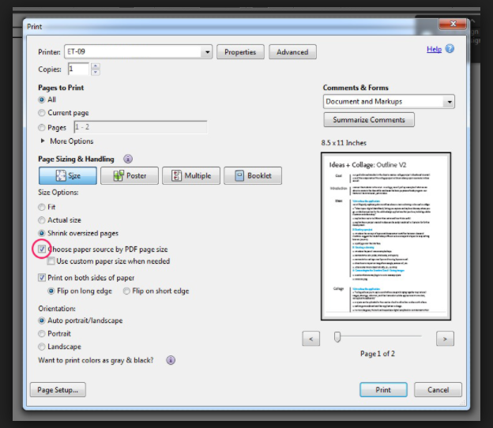
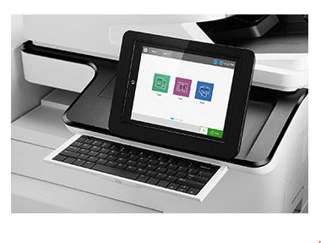
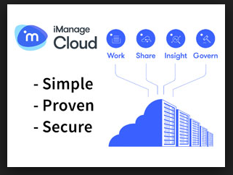
Goals, Expectations and Scenario
“
Martha is a paralegal that supports anywhere between 2 to 6 cases at one time. She works long hours in front of her computer screen. She is constantly finding ways to maximize her time and creates her own shortcuts using excel. Scanning and printing can be very time consuming and the printers never work likes she want them too.
I should be able to find a way to take the redundancies out of my work using the multiple tools I have at my fingertips.
I want to be able to have access to all my cases/matters whenever I need it and wherever I am so I am not constantly running back to my desk.
Business Goal: HP provides a connected experience between the paralegals and the attorneys using our printing devices.
Business Goal: HP to gain more business with A3 devices by creating API’s Legal verticals.
Sylvia Williams
“
Collaboration
Document Management
Preparing Documents
Printing
Scanning
DOING
Adobe is a must and is used for:
  Digitizing documents
  Organizing trial binders
  Redacting as well as bate stamping
Excel is also used to create formulas that easily work with Adobe
When I scan, I scan to email than go back to my desk and open the email in order to rename it as well as file it in different locations
Heavy Emails and phone calls is used to communicate with attorneys, paralegals, as well as the client.
Files are saved to our internal server
Files are saved on the document management (iManage) if the attorney asks for it there or for version control
When I print, I have to open up each PDF file separately and then put them in order to print.
It is very difficult to get all the documents I need from attorneys and at times I am constantly bothering them for these documents
It is frustrating to have to track down documents from different places to complete the binders
The work arounds that I do in order to create trial binders requires up front time but in the long run makes my job easier
Frustrated that I have to combine all information and right click each PDF in order to send it to the printer.
Never know when it will print out because no way of knowing where at in print queue
I don’t like the touchscreen keypad when I scan a document in so I just press the number 1 and then go back to my desk to do the work. Seems like there should be a way to scan it directly into the server.
FEELING
Have a system that all files go to that can be accessed by everyone on that matter/case.
A system that is secure but allows all documents accessible to who is working on that matter/case
Accessing the case/matter and formatting from the printer to give it a quick overlook
Pull print would help as well as an idea of where the print job is in queue.
Scanning from the A3 device would be so useful but a keyboard is necessary . Preview is very useful for smaller scan jobs.
OPPORTUNTIES

